Slide 1
Group 6
Charlie Crewe, George Flude, Alex Polley and Callum Walsh.

Slide 2
Our goals & learning outcomes.
Goal: Use coercive monetisation techniques to generate revenue for a mobile game.
Learning outcomes
Establish constraints that keep the project on track, and maintains a consistent flow of design and management.
Able to realistically adhere to milestones and set deadlines for the project.
Gain an understanding of various monetisation methods used within the mobile game industry.

Slide 3
Pocket Pet Concept
Mechanics
Feeding creatures
Racing against diminishing values
Minigames
Game Loop
ENGAGE
Challenges
Keep pet alive
Obstacle
Time
CUSTOMISE
REWARD

Slide 4
Target Audience
7-12 year olds
Female
Impact of theme and art.
Appropriate themes

Slide 5
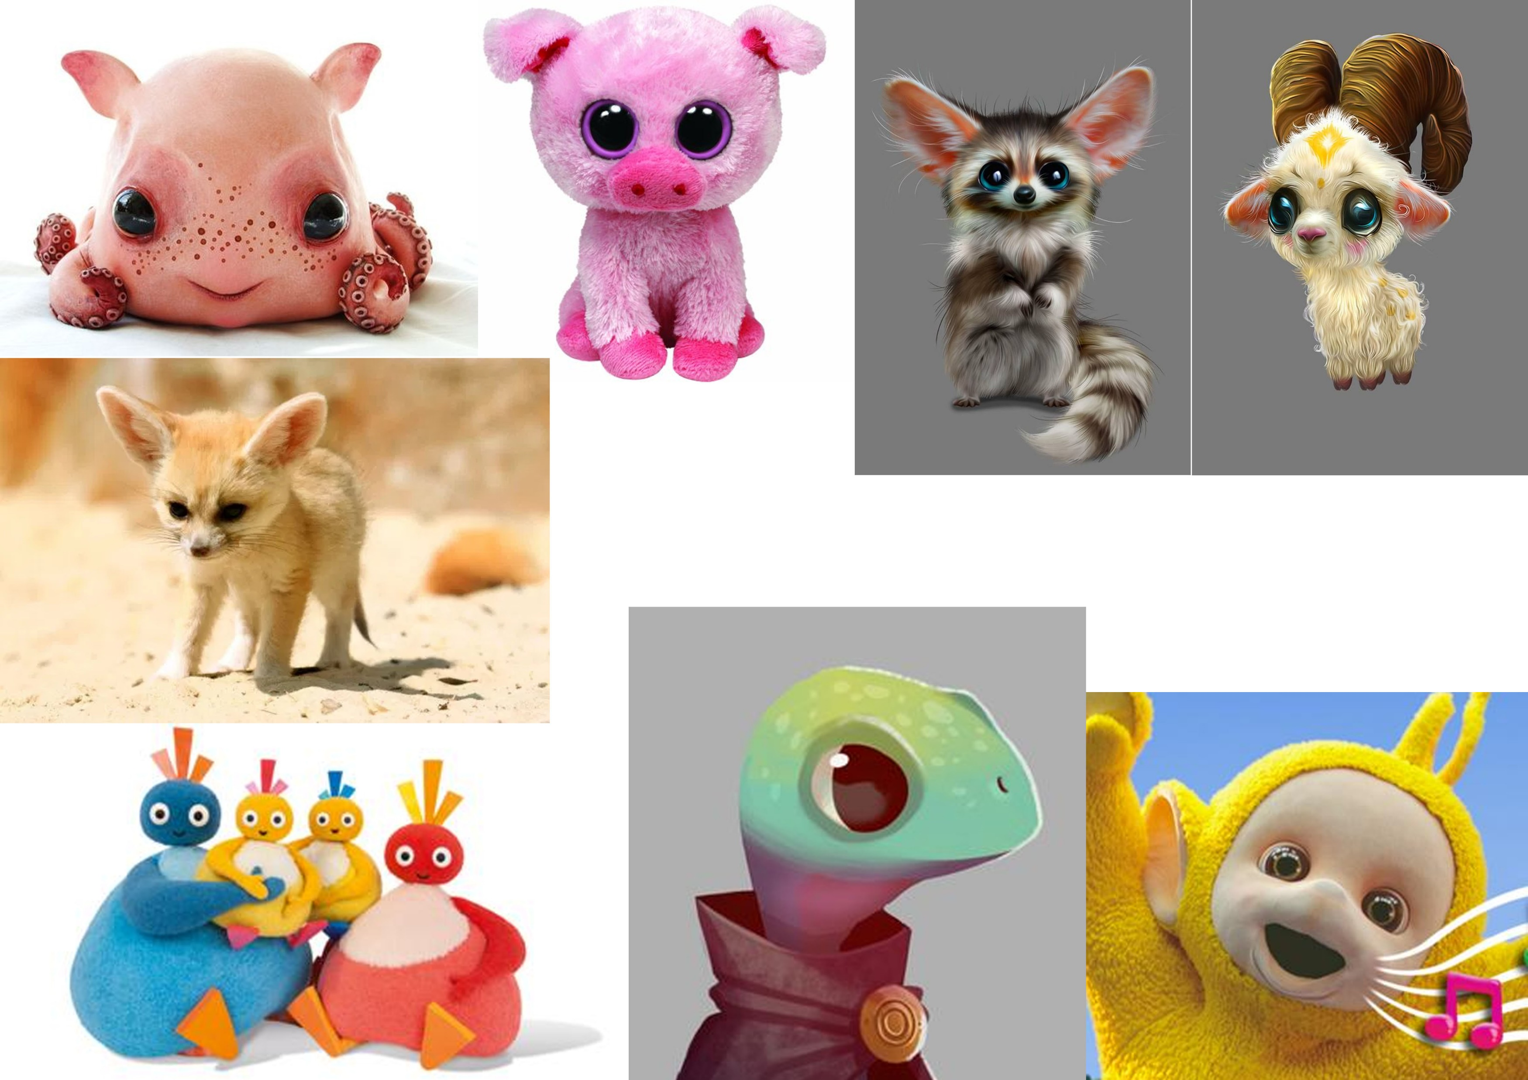
Mood boards

Slide 6
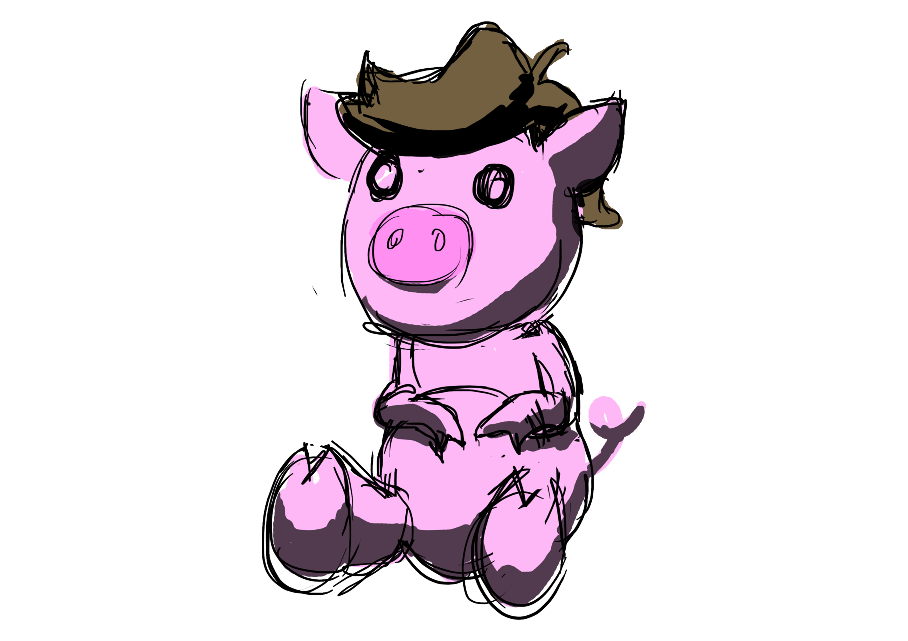
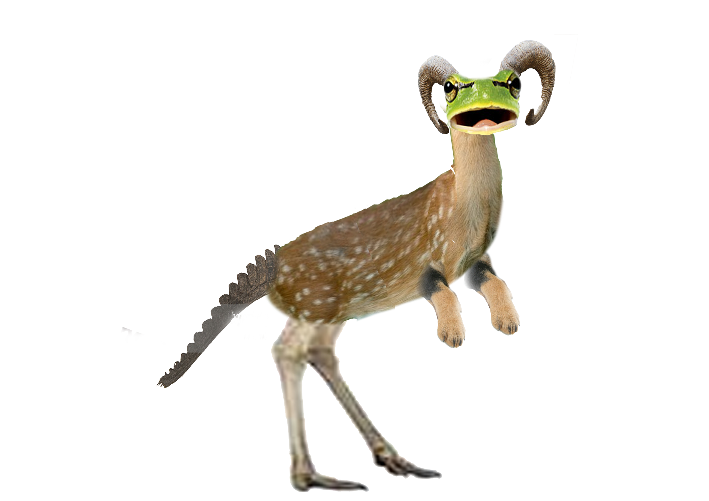
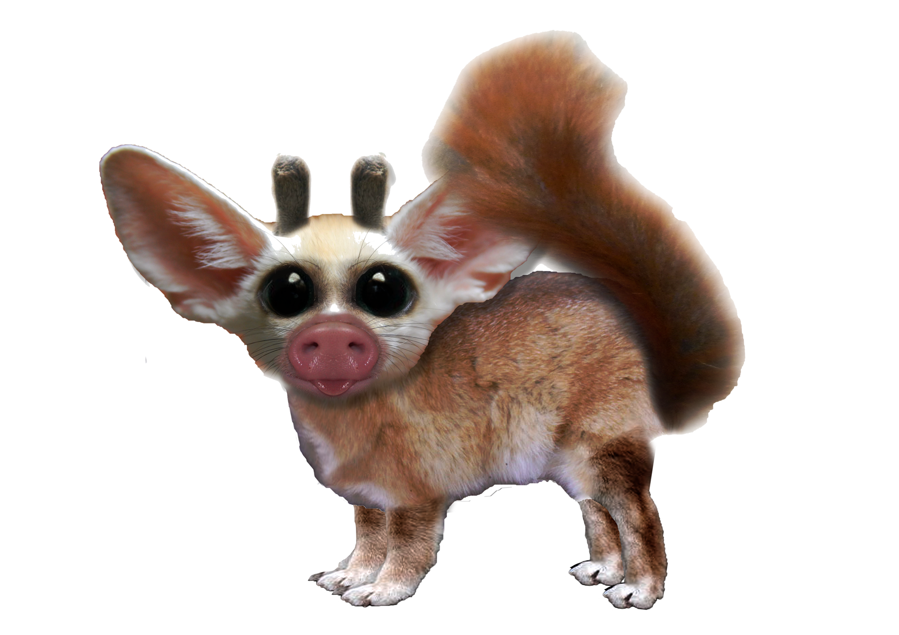
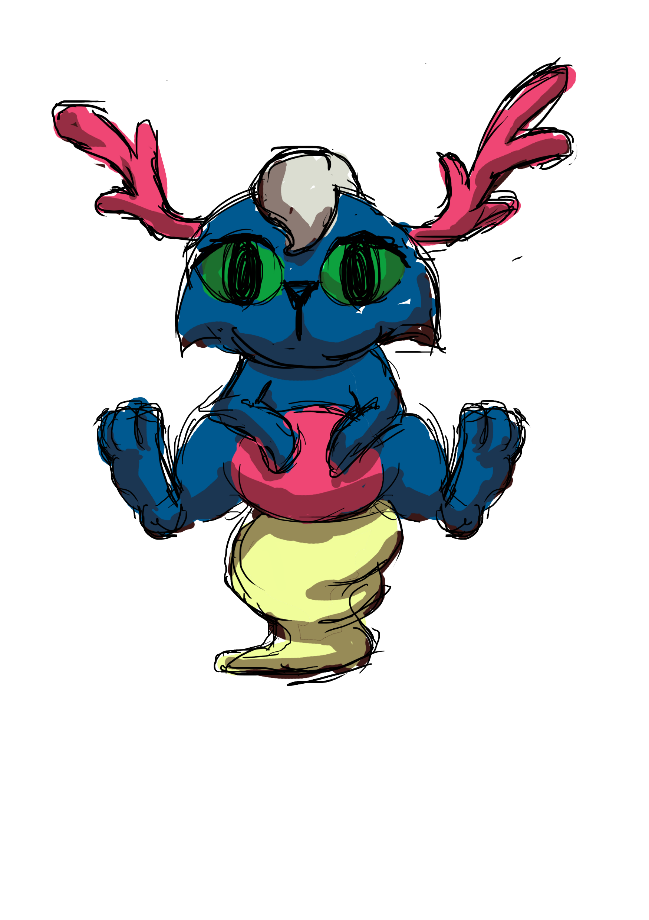
Concept art

Slide 7
Monetisation
Upgrades
Rewards
Using Schedules and contingencies
In game currency
Customisation
Clothing
Avatars
Gacha

Slide 8
Infinite runner concept
On the rails
Limits input needed
2D camera perspective
Game Loop
ENGAGE
CUSTOMISE
REWARD

Slide 9
Target audience
16-25
Fast, short bursts of action
More susceptible to coercive monetisation techniques

Slide 10
Mood boards
Here we’ll place and discuss mood boards for the Infinite runner

Slide 11
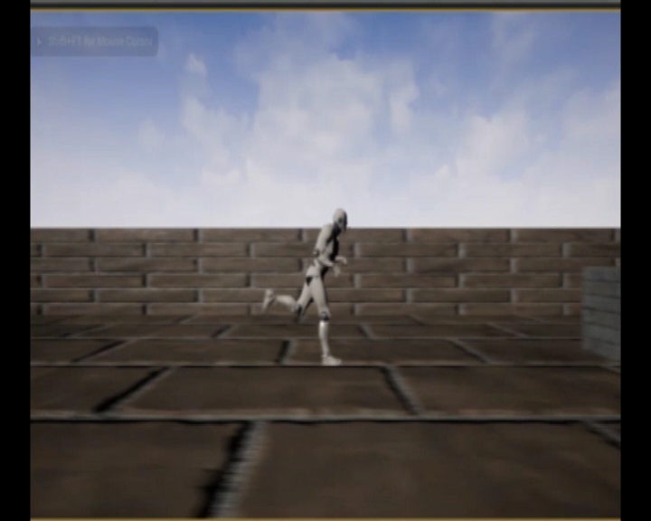
Prototype

Slide 12
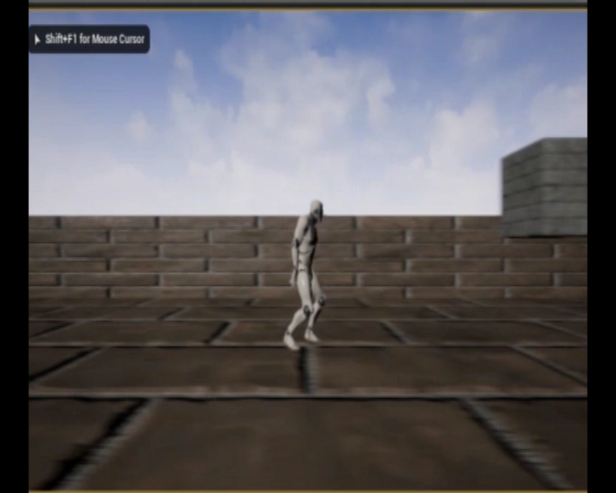
Prototype

Slide 13
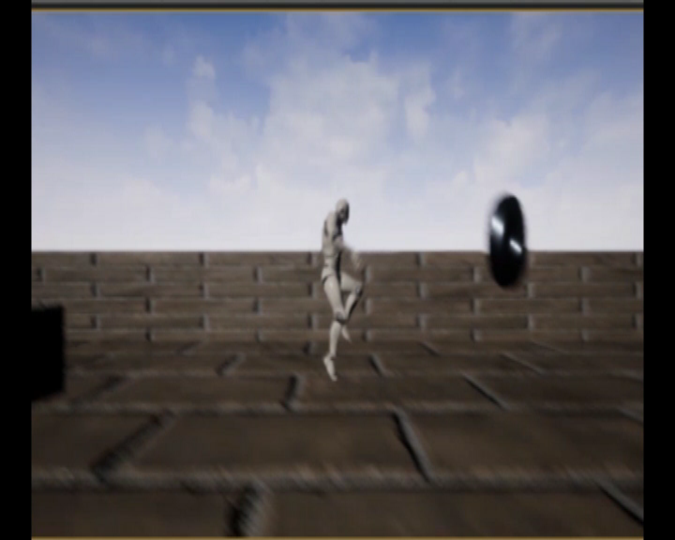
Prototype

Slide 14
Monetisation
Powerups
Pay to make gameplay easier
Personalisation
Customisation
Avatars
Unlockable/Mementos
Wallpapers
Achievements

Slide 15
Twitch base game Concept
Limit input to single tapping action
Fast and short bursts of gameplay
Accumulative rewards that require in game currency to avoid removal if you die

Slide 16
Target audience
18-25
Fast, short bursts of gameplay
Repetitive actions
Coercive monetisation has greater influence

Slide 17
Mood boards
Here we’ll discuss and place our Twitch base game’s mood board.

Slide 18
Concept art
Here we’ll place and discuss any concept art

Slide 19
Prototype
Here we’ll discuss and place a video of our prototype for our Twitch base game.

Slide 20
Monetisation
Rewards
In-game currency
Items
Marketplace to sell items for in game currency
Earn more in game currency
Online marketplace
Customisation and Personalisation
Avatars
Themes
Respawn spends in game currency
Reward removal
Daily rewards
Accumulate to weekly rewards

Slide 21
Thank you, any question?

